Slide 1



Session 1:
Introduction to Computer Vision
1
Notes:
1

Slide 2
Who are we?
Can Nguyen
TIC Computer Vision Team Lead
PhD. Tuong Phan
TIC Computer Vision Consultant

Slide 3
Outline
What is Computer Vision?
How does it work?
Practice: read and extract information from an image
Computer Vision application
Deep Learning
Final project assignment

Slide 4
What is Computer Vision?
Computer Vision involves analyzing
images to produce useful information

Slide 5
What is Computer Vision?
Recognition
Reorganization
Reconstruction
Malik, J., Arbeláez, P., Carreira, J., Fragkiadaki, K., Girshick, R., Gkioxari, G., Gupta, S., Hariharan, B., Kar, A. and Tulsiani, S.
The three R's of computer vision. 2016 Pattern Recognition Letters, 72, C, 4-14.

Slide 6
What is Computer Vision?
Recognition is about attaching semantic category labels to objects and scenes as well as to events and activities.
Reorganization is the “perceptual organization” in human vision.
Reconstruction is about recovering 3D geometry of the world from one or more of its images.

Slide 7
What is Computer Vision?
Recognition is about attaching semantic category labels to objects and scenes as well as to events and activities.
Reorganization is the “perceptual organization” in human vision.
Reconstruction is about recovering 3D geometry of the world from one or more of its images.

Slide 8
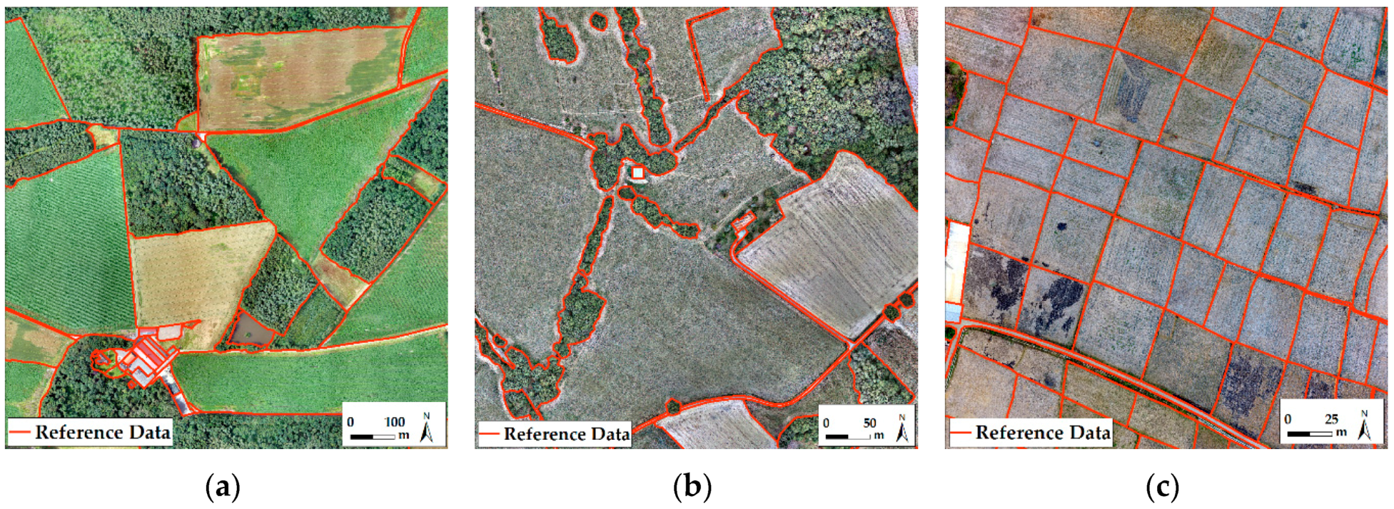
What is Reorganization?
Contour Detection
Crommelinck, S., Bennett, R., Gerke, M., Yang, M.Y. and Vosselman, G. Contour Detection for UAV-Based Cadastral Mapping. 2017 Remote Sensing, 9(2):171

Slide 9
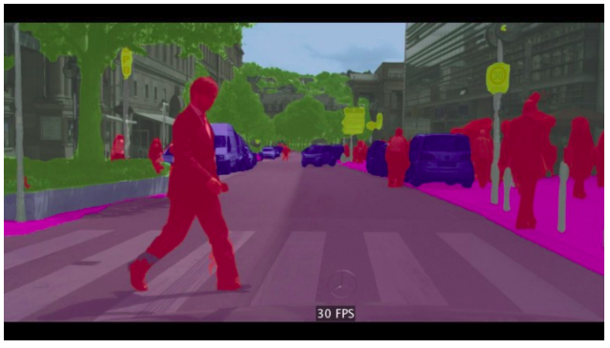
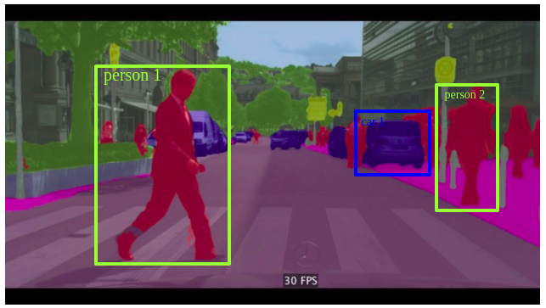
What is Reorganization?
Semantic and Instance Segmentation
https://medium.com/@keremturgutlu/semantic-segmentation-u-net-part-1-d8d6f6005066

Slide 10
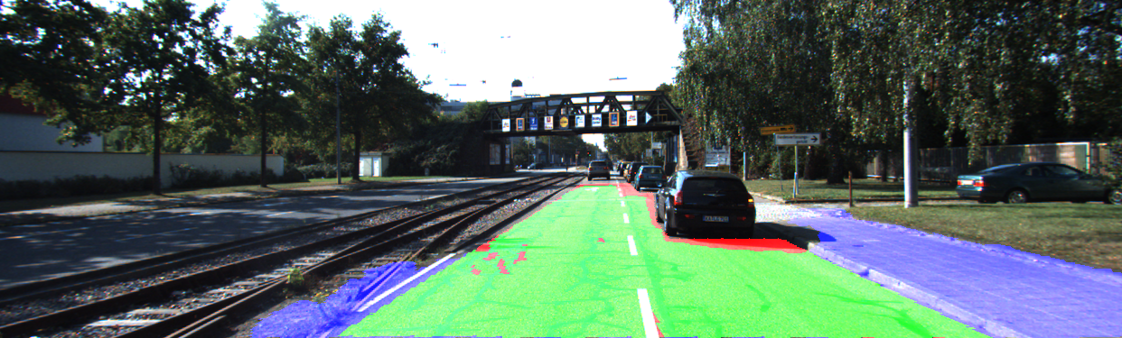
What is Reorganization?
Autonomous Driving
Kitti Road Dataset Training (Source: http://www.cvlibs.net/datasets/kitti/eval_road_detail.php?result=3748e213cf8e0100b7a26198114b3cdc7caa3aff)

Slide 11
What is Computer Vision?
Recognition is about attaching semantic category labels to objects and scenes as well as to events and activities.
Reorganization is the “perceptual organization” in human vision.
Reconstruction is about recovering 3D geometry of the world from one or more of its images.

Slide 12
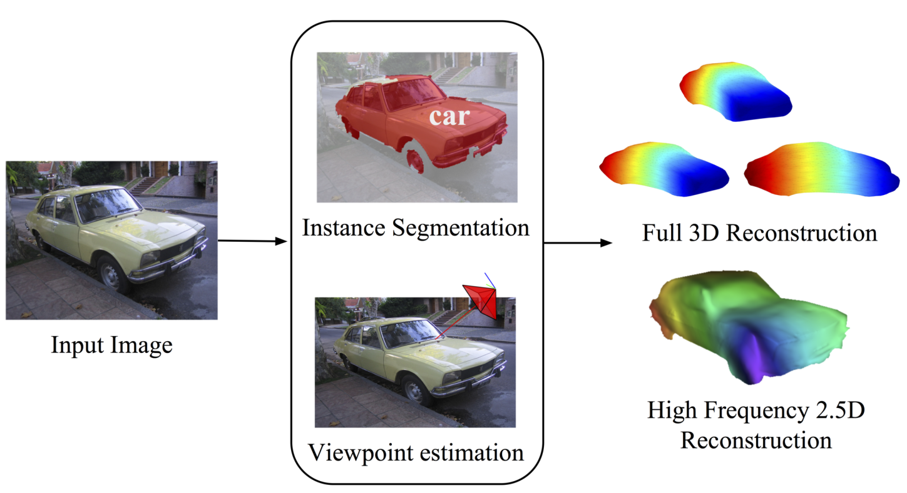
What is Reconstruction?
Viewpoint Reconstruction
Kar, A., Tulsiani, S., Carreira, J., & Malik, J. (2015). Category-specific object reconstruction from a single image. 2015 IEEE Conference on Computer Vision and Pattern Recognition (CVPR), 1966-1974

Slide 13
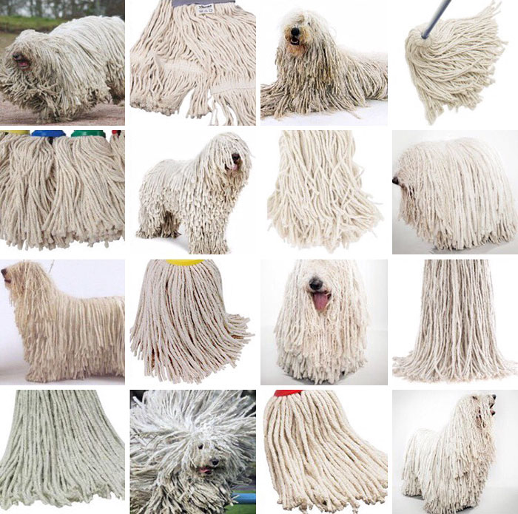
What is Recognition?

Slide 14
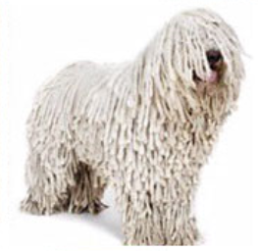

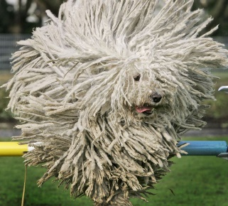

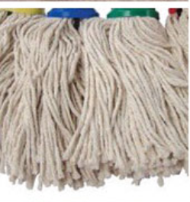
How Recognition works?
Sheep Dog
?
Sheep Dog
Machine LearningModel
Inputs or Labels
Predictions
Sheep Dog: 60% confidence
mop
mop

Slide 15

Practice: Extract information from images

Slide 16
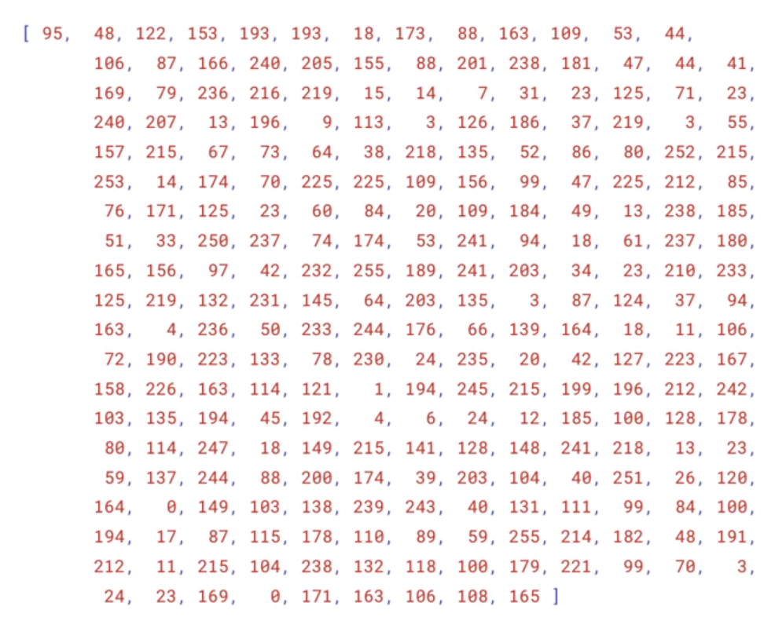

Practice: Extract information from images

Slide 17
Practice: Extract information from images
Docker:
GitHub:

Slide 18
Practice: Extract information from images

Slide 19

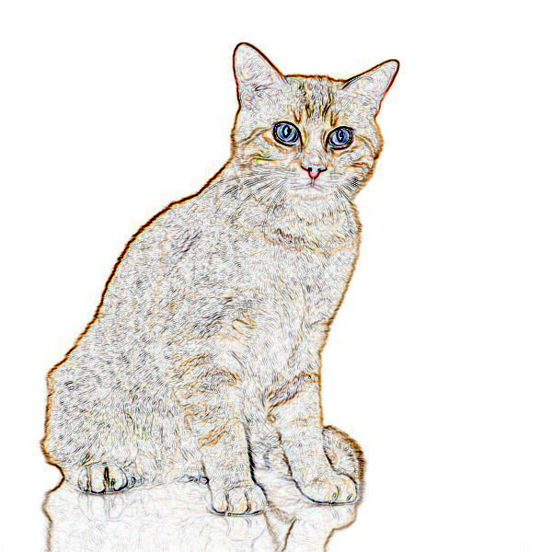
Recognition clues
Color
Texture x
Pattern x
Shape
Association x

Slide 20
Computer Vision applications
RPA
Security
Detecting events
Organizing information
Modeling objects or environments
Interaction
Automatic inspection
Much more … (sua lai cho no thanh recognition)

Slide 21
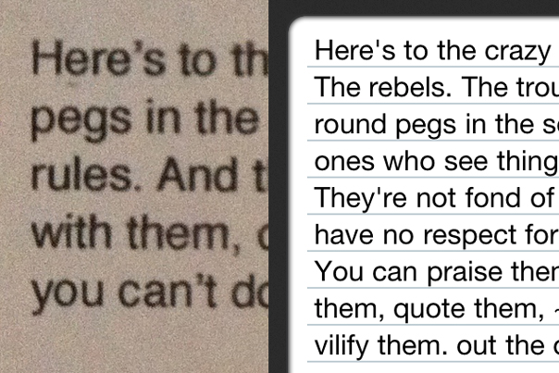
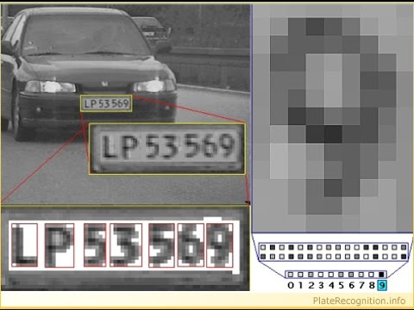
Optical Character Recognition (OCR)
Definition: The mechanical or electronic conversion of images of typed, handwritten or printed text into machine-encoded text

Slide 22
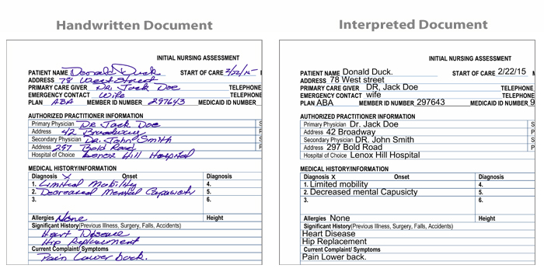
Optical Character Recognition (OCR)
Converting paperwork into digital data

Slide 23
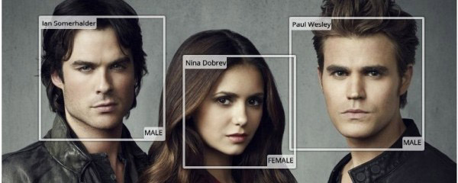
Face Recognition
Definition: A facial recognition system is a technology capable of identifying or verifying a person from a digital image or a video frame from a video source.

Slide 24
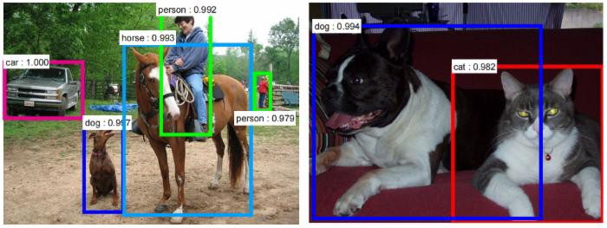
Object Detection

Slide 25
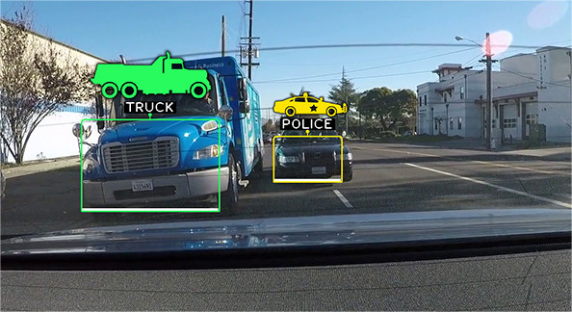
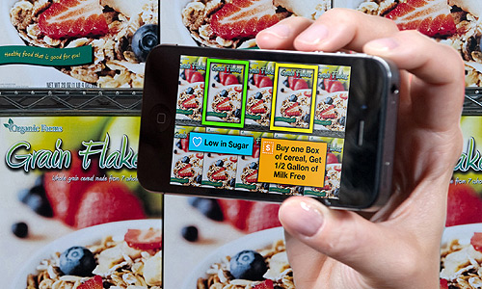
Object Detection Application
Self-driving car
Retail

Slide 26
Why is Computer Vision difficult?
Data
Computationally intensive
We do not understand the recognition problem
(check idea)

Slide 27
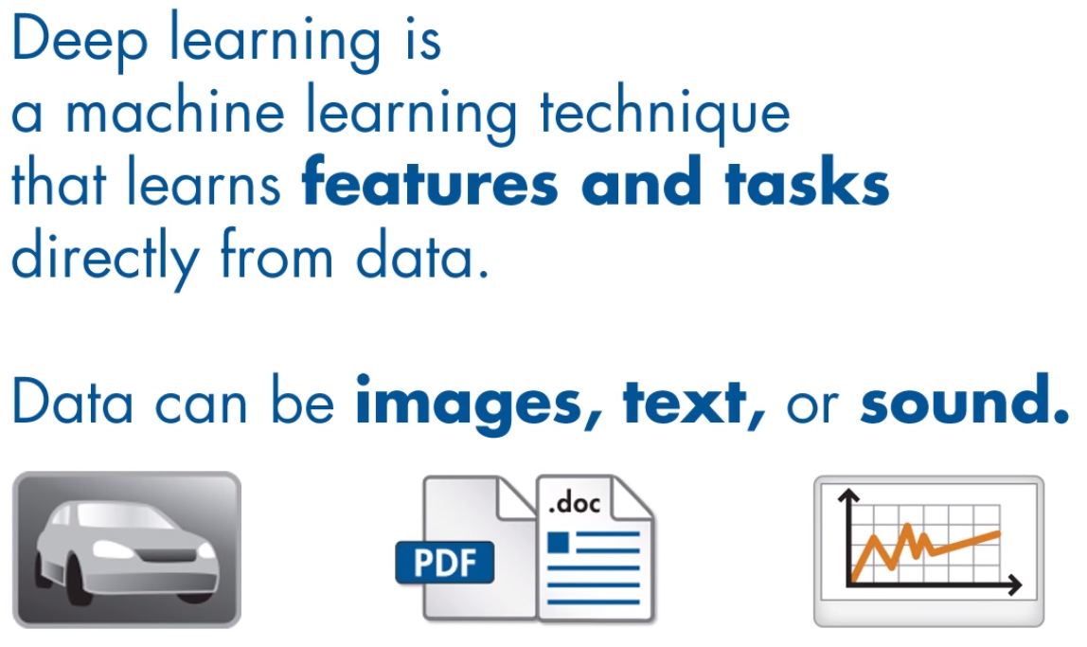
What is Deep Learning?

Slide 28
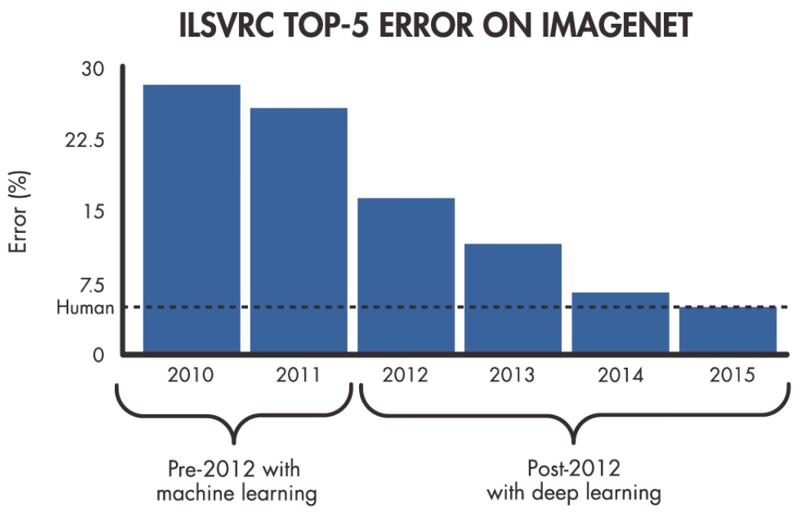
Why Deep Learning?

Slide 29
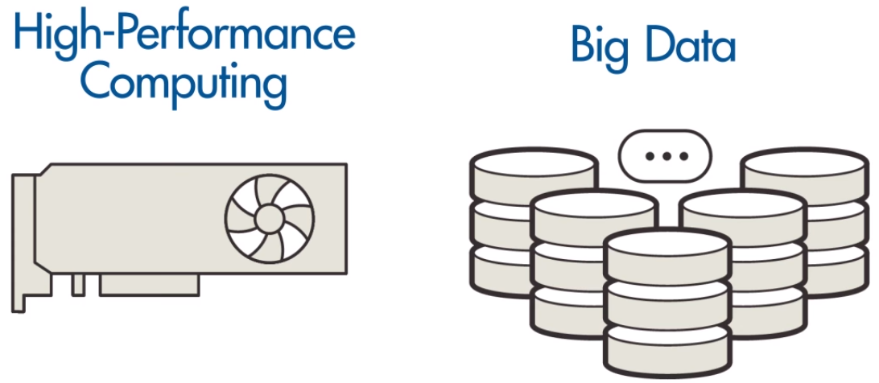

Slide 30
Video demo cho object detection

Slide 31
Final project
Face gender recognition
Gesture recognition
Facial expression recognition

Slide 32
Q&A

Slide 33
Thank you!

